Slide 1
Experimental Design for One-Sided Matching Platforms
Chenran Weng (USTC → UC Berkeley)
Xiao Lei (HKU)
Nian Si (Stanford MS&E → UChicago Booth → HKUST IEDA)

Slide 2
A/B Tests
Estimate global treatment effect.

Slide 3
Two-sided matching marketplaces
✓
✓
✓
×
×
✓
✓
×

Slide 4
Two-sided matching marketplaces: user randomization
✓
✓
×
✓
×
✓
✓
×
×

Slide 5
One-sided matching marketplaces
Round 1
Round 2
Users are matched with another user.
Repetitive interactions among users.
Users may arrive and exit.

Slide 6
One-sided matching marketplaces: user randomization
Round 1
Round 2
Round 3
Treatment assignment of an user may affect the outcome of its opponent.
Treatment assignment may also affect the matching result.

Slide 7
Example 1: Player versus player (PVP) game
Treatment: modify the user interface to simplify user operations in the game.
Increase the win rate of the treatment user and decrease the win rate of their opponent.

Slide 8
Example 2: anonymous chat platform
Randomly match strangers to chat online.
Treatment: AI-assisted chat helper.
Enhance the experience of both treatment users and their matching partners.
https://github.com/edith141/Anonymous-Chat-App

Slide 9
Research questions
Which types of randomization can reduce interference in one-sided matching platforms?
What are the estimators?

Slide 10
User-level randomization
Round 1
Round 2
Round 3
Users will keep its treatment assignment during the entire experiment.
A treatment user can be matched with a control user.
10

Slide 11
Match-level randomization
Round 1
Round 2
Round 3
In the treatment match, both users are in treatment and vice versa.
Users may switch between control and treatment designs.

Slide 12
Split the world
×
No interference between treatment and control units, but affect market thickness
External validity: the treatment/control worlds cannot mimic the whole worlds.
Experimentation cost: decreasing market thickness can lower user satisfaction..
Engineering costs: dividing the system perfectly into two is challenging.
Systematic bias: in practice, divisions might occur across different servers, such as U.S. and Asian servers.

Slide 13
Roadmap
Background and literature review
Model
Experimental design
User randomization
Match randomization
Linear regression estimators in user randomization
Simulation results

Slide 14
Interference
Violate Stable Unit Treatment Values Assumption (SUTVA);
Empirical evidence: Blake and Coey [’14] and Fradkin [’15].

Slide 15
Literature review
Interference in two-sided marketplaces: Johari et al. [’22], Li et al. [‘22], Bajari et al. [’21] , Harshaw et al. [’21], Pouget-Abadie et al. [’19], Holtz et al. [’20], Wager and Xu [’21], Basse et al. [’16], Liao and Kroer [23’], Bright et al. [’22], Dhaouadi [’23], etc.
Network interference: Hudgens and Halloran [’08], Toulis and Kao [’13], Gui et al. [’15], Li and Wager [’22], Aronow and Samii [’17], Candogan et al. [’23], Ugander et al. [’13], Basse et al. [’19], Ugander and Yin [’23], Basse et al. [’24], etc.
One-sided markets are ex post networks. However, the network’s structure is endogenous.

Slide 16
Model: platform dynamics
At the beginning of each time t=1,2,…, new users (potentially with different types) arrive at the platform.
The platform pairs active users together according to some rules.
The player interacts (plays a game) with his/her opponent in that match.
Towards the end of each time unit, after the interaction, active users decide whether to stay on the platform or exit and become inactive.
Metric: the steady-state average session length of users .
Session length: the number of games that the user plays before exiting.

Slide 17
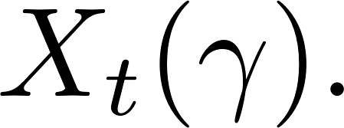
Model: details
User types:
Poisson arrivals with arrival rates
The number of active users of type 𝛾 at the start of time unit t (before the matching):
Weighted matching mechanism with
Markovian exit probability:

Slide 18
Model: discussions
We allow heterogeneous users and a general weighted matching mechanism.
Markovian exit probability
The exit probability depends solely on the last match.
We will relax this assumption and propose an estimator.

Slide 19
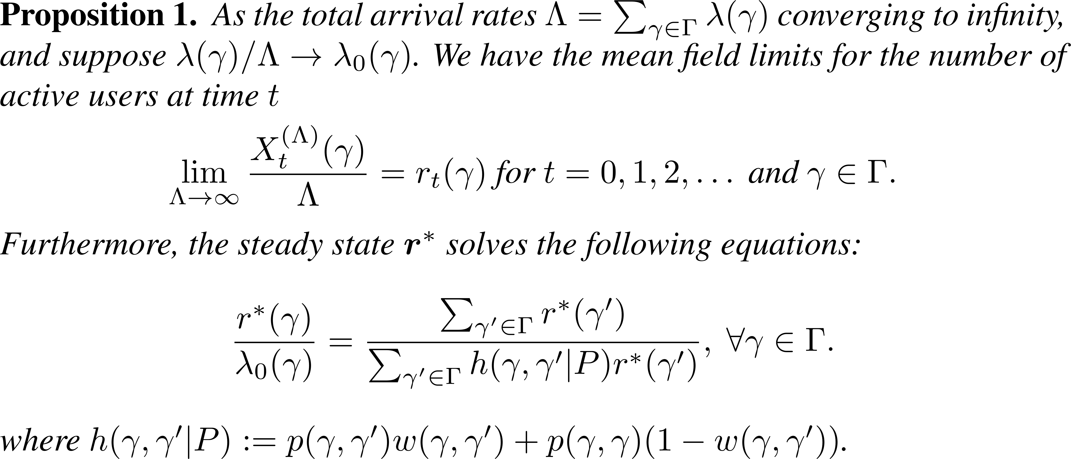
Mean field system

Slide 20
Global treatment effect
Intervention changes the exit probability.
Global control: and the steady-state average session length
Global treatment: and the steady-state average session length
Global treatment effect:

Slide 21
User-level randomization (UR)
The exit probability of a control user of type 𝛾 when matching with a treatment user 𝛾’: similarly for
Treatment assignment probability:
Steady-state session length:
Naïve estimator:

Slide 22
Match-level randomization (MR)
Treatment assignment probability:
Average exit probability:
Naïve estimator:

Slide 23
Assumption
Remark: Heterogeneous users but homogeneous treatment effects.

Slide 24
The direction of biases: UR
Remark: sometimes the sign is wrong!

Slide 25
The direction of biases: UR with wrong sign

Slide 26
The direction of biases: MR

Slide 27
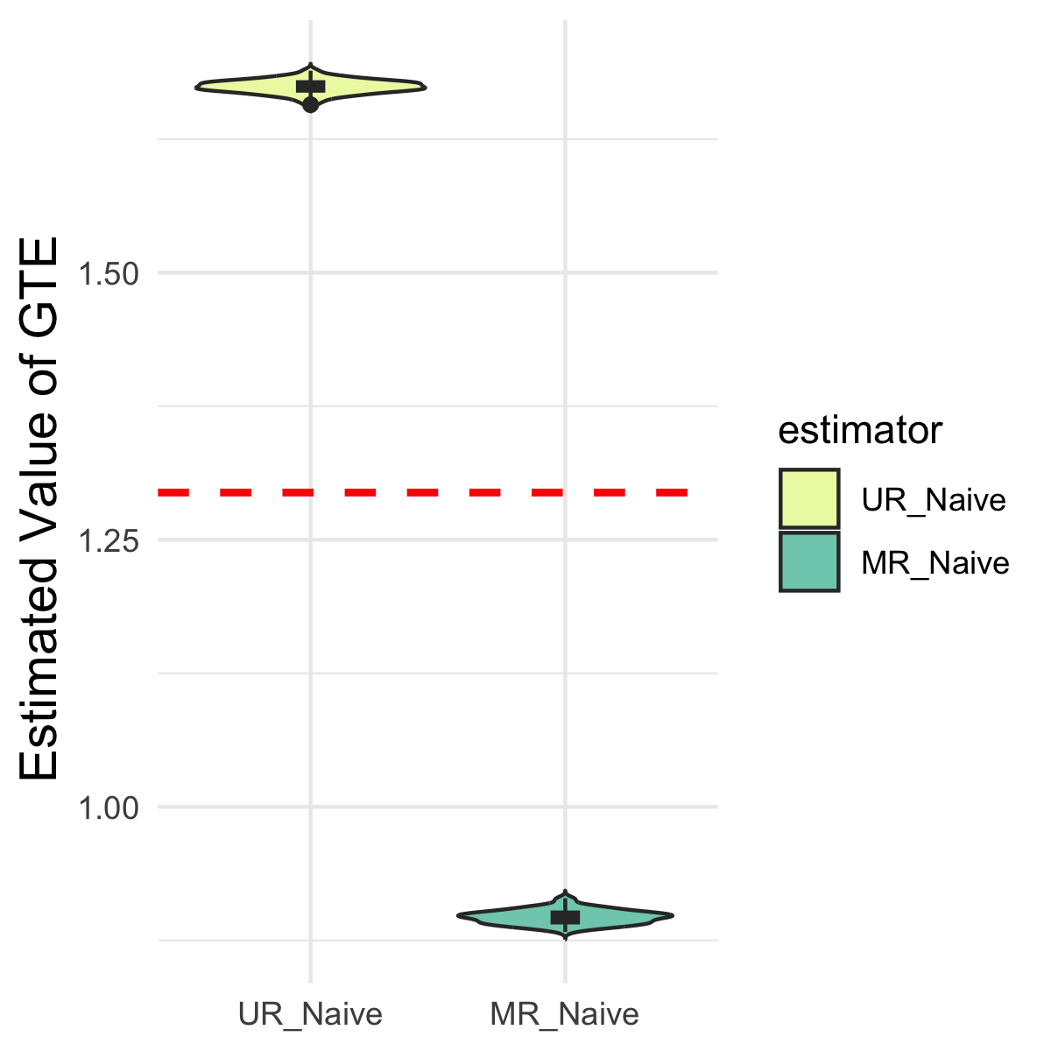
Non-Markov?
The exit probability linearly depends on the last two matches

Slide 28
Non-Markov?
The exit probability linearly depends on the last two matches

Slide 29
Non-Markov?
The exit probability linearly depends on the last two matches

Slide 30
Robust and low bias?
User randomization is robust.
Match randomization has a low bias under strict assumptions.
Can we design experiments and estimators to be robust and achieve low biases?

Slide 31
An initial thought
User-level randomization with an estimator:
Variance is huge: only use a small set of data.
Selective bias:

Slide 32
Our approach: UR with a linear regression estimator
Define as the ratio of the number of opponents in treatment to the total number of opponents for a treatment user.
Round 1
Round 2
Round 3

Slide 33
Our approach: UR with a linear regression estimator
Define as the ratio of the number of opponents in treatment to the total number of opponents for a treatment user.
Define as the ratio of the number of opponents in control to the total number of opponents for a control user.
Regress on to obtain the intercept and slope Similarly, we obtain
The LR estimator:

Slide 34
The linear regression estimator: reasoning
LR:
is the prediction of when
It corresponds to the global treatment/control regimes.
But, the true relationship between and is not linear.
The prediction is still biased.
Can we analyze the bias?

Slide 35
Bias analysis (informal)

Slide 36
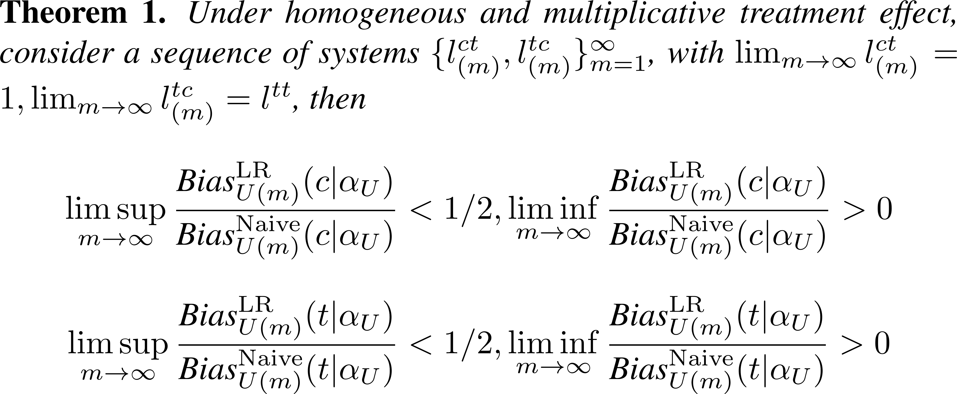
Bias analysis 1: small interference regime

Slide 37
Bias analysis 2: small exit probability regime

Slide 38
Comparison with literature
The linear regression estimator is common in network interference literature [Bramoull´e et al. ’09, Toulis and Kao ’13, Harshaw et al.’ 21]. However,
The network that results from one-sided matching is endogenous and unknown ex ante, while prior research on network interference typically assumes that the network structure is fixed and known.
We do not assume a linear structure. Instead, we use the linear regression as a tool to debias.
We allow different linear responses in treatment and control.

Slide 39
Simulation results

Slide 40
Setup
Three types.
Purely randomized matching:
The total arrival rate and fixed time horizon T=100.
Four methods:
UR_Naive: the naïve estimator in user randomization;
UR_LR: the linear regression estimator in user randomization;
MR_Naive: the naïve estimator in match randomization;
MR_DQ: the Differences-In-Q's (DQ) estimator.¹
¹Farias, Vivek, et al. "Markovian interference in experiments." arXiv:2206.02371

Slide 41
Homogeneous treatment effects and Markovian system
Unbiased

Slide 42
Heterogeneous treatment effects and Markovian system
Lowest bias

Slide 43
Non-Markovian system and Homogeneous treatment effect
Lowest bias

Slide 44
Conclusion
User-level randomization:
Robust but the naïve estimator has huge bias.
The linear regression estimator is robust and has small bias.
Match-level randomization:
Under homogenous treatment effect and Markovian exit assumption, the bias is small.
If either of those violate, match randomization may incur huge bias.
For some other metrics, MR may not even feasible.

Slide 45
Q&A?

Slide 46
Homogeneous and multiplicative treatment effects

Slide 47
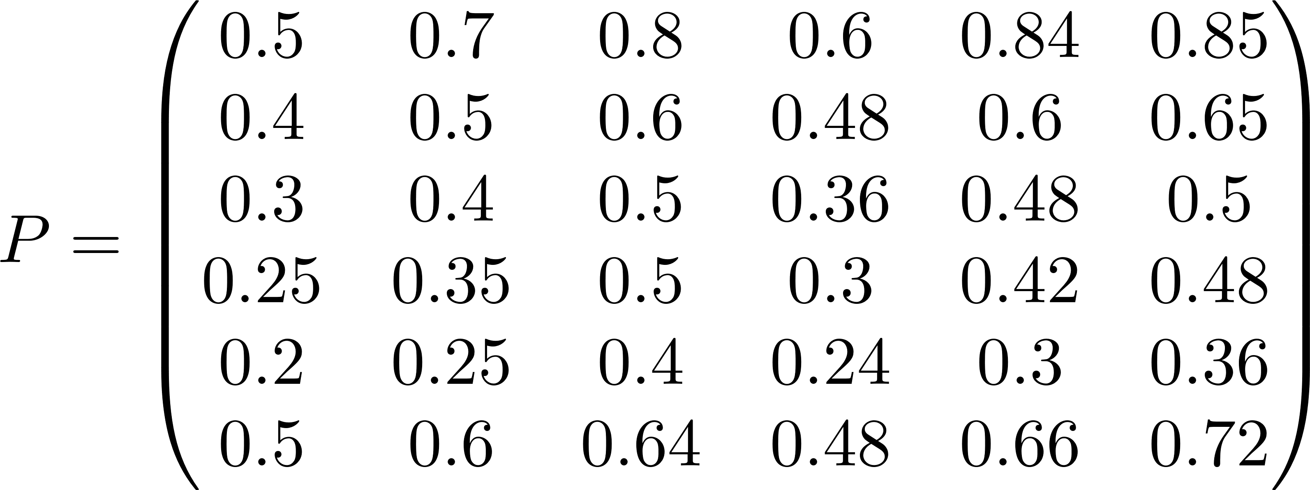
Heterogeneous treatment effects

Slide 48
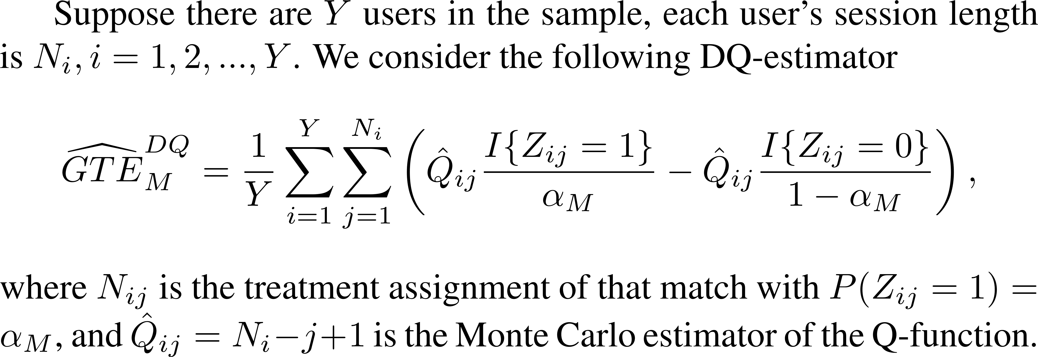
Comparison with Difference-in-Q estimator in MR

