Slide 1
On the Foundation of Distributionally Robust Reinforcement Learning
Shengbo Wang (Stanford)
Nian Si (Stanford → Chicago Booth → HKUST)
Jose Blanchet (Stanford)
Zhengyuan Zhou (NYU Stern)

Slide 2
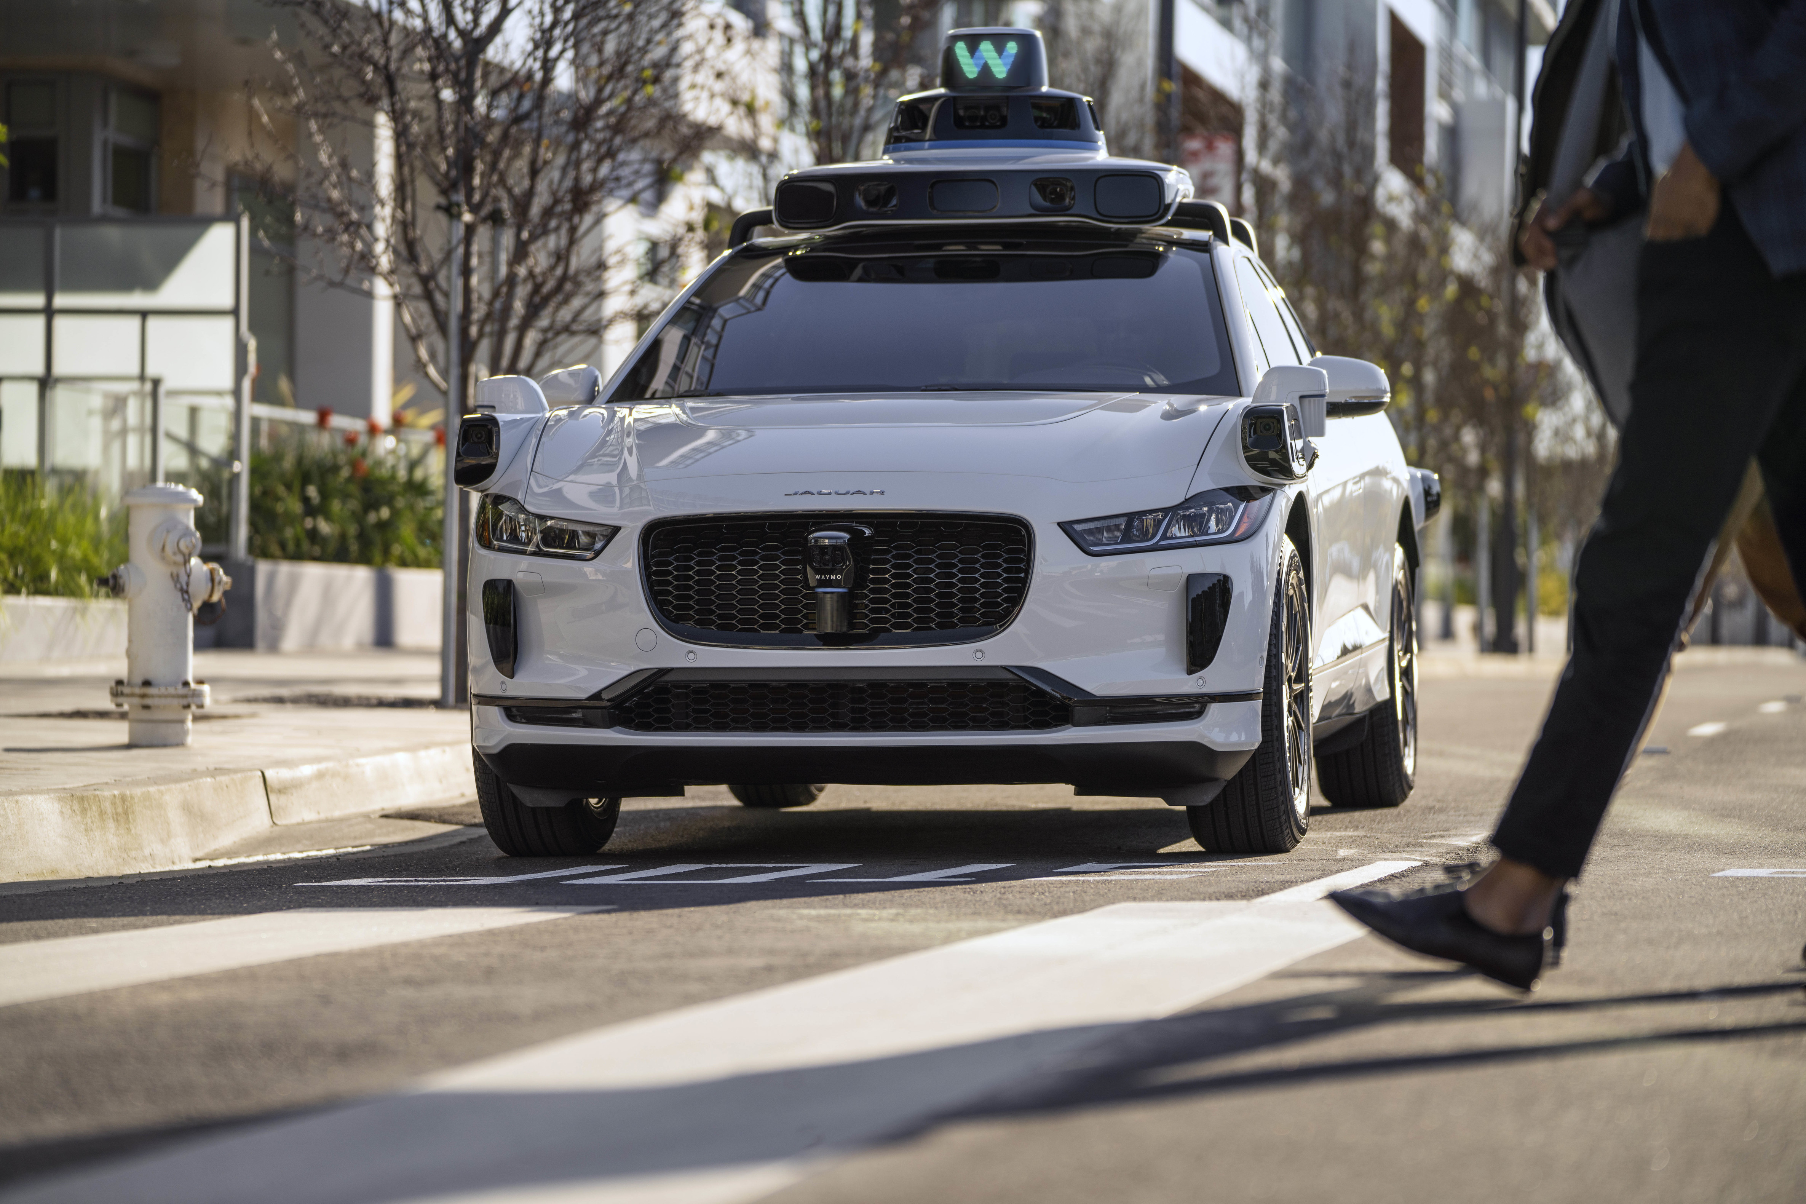
Motivation: Auto-Driving Car Trained from a Simulator
Real environment
Simulator

Slide 3
Distributionally Robust MDP

Slide 4
Distributionally Robust MDP
Adversary:
History-dependent V.S. Markov V.S. Static?
SA-rectangular V.S. S-rectangular?
Convex V.S. Non-convex?

Slide 5
Distributionally Robust MDP
Controller:
Randomized V.S. Deterministic?

Slide 6
Distributionally Robust Dynamic Programming Principle
?
$$=$$
Distributionally robust dynamic programming principle
(a.k.a Bellman equation)

Slide 7
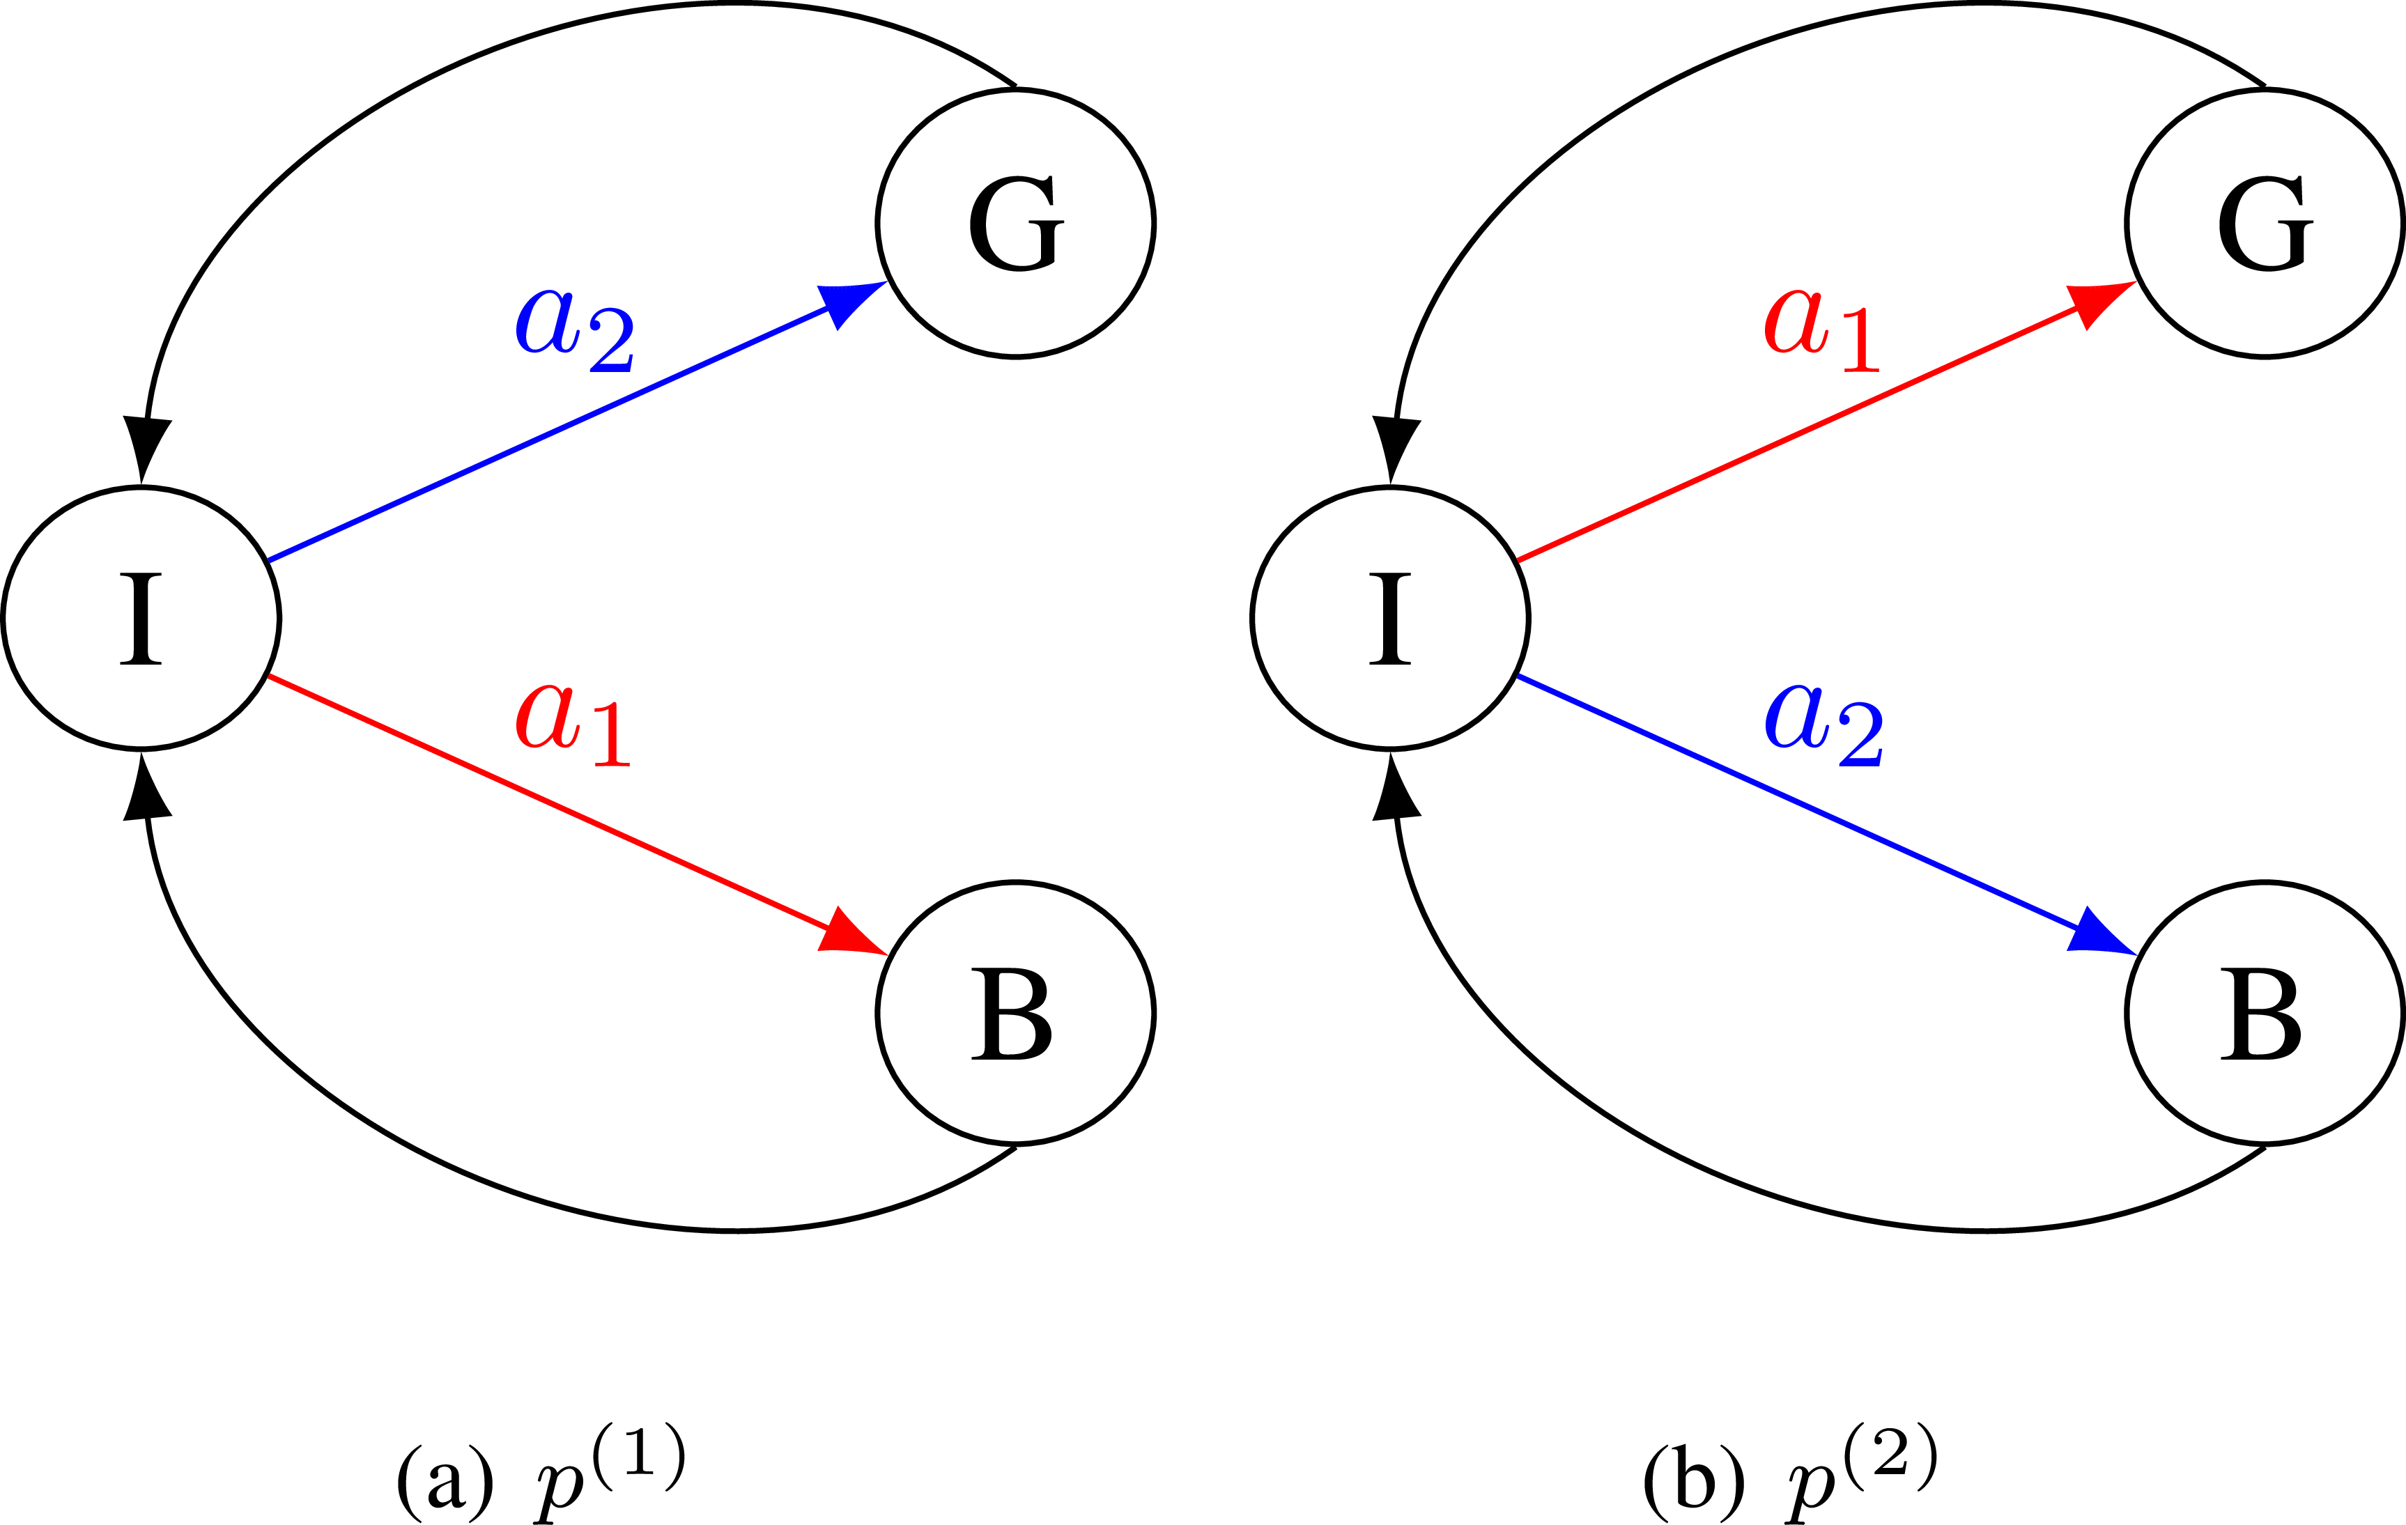
Adversary’s Adaptivity
History-dependent adversary:
At time $2k$, the adversary can choose $p^{(1)}$or $p^{(2)}$ based on the previous controller’s action.
Markov adversary:
At different times $2k$ and $2k^{′},$the adversary can choose different $p$s.
Markov time-homogeneous (static) adversary:
For any time $2k$ with any histories, the adversary can only choose the same $p$s.
0 1 0 1
2 3 2 3
⋮ ⋮ ⋮ ⋮
2k 2k+1 2k 2k+1
⋮ ⋮ ⋮ ⋮

Slide 8
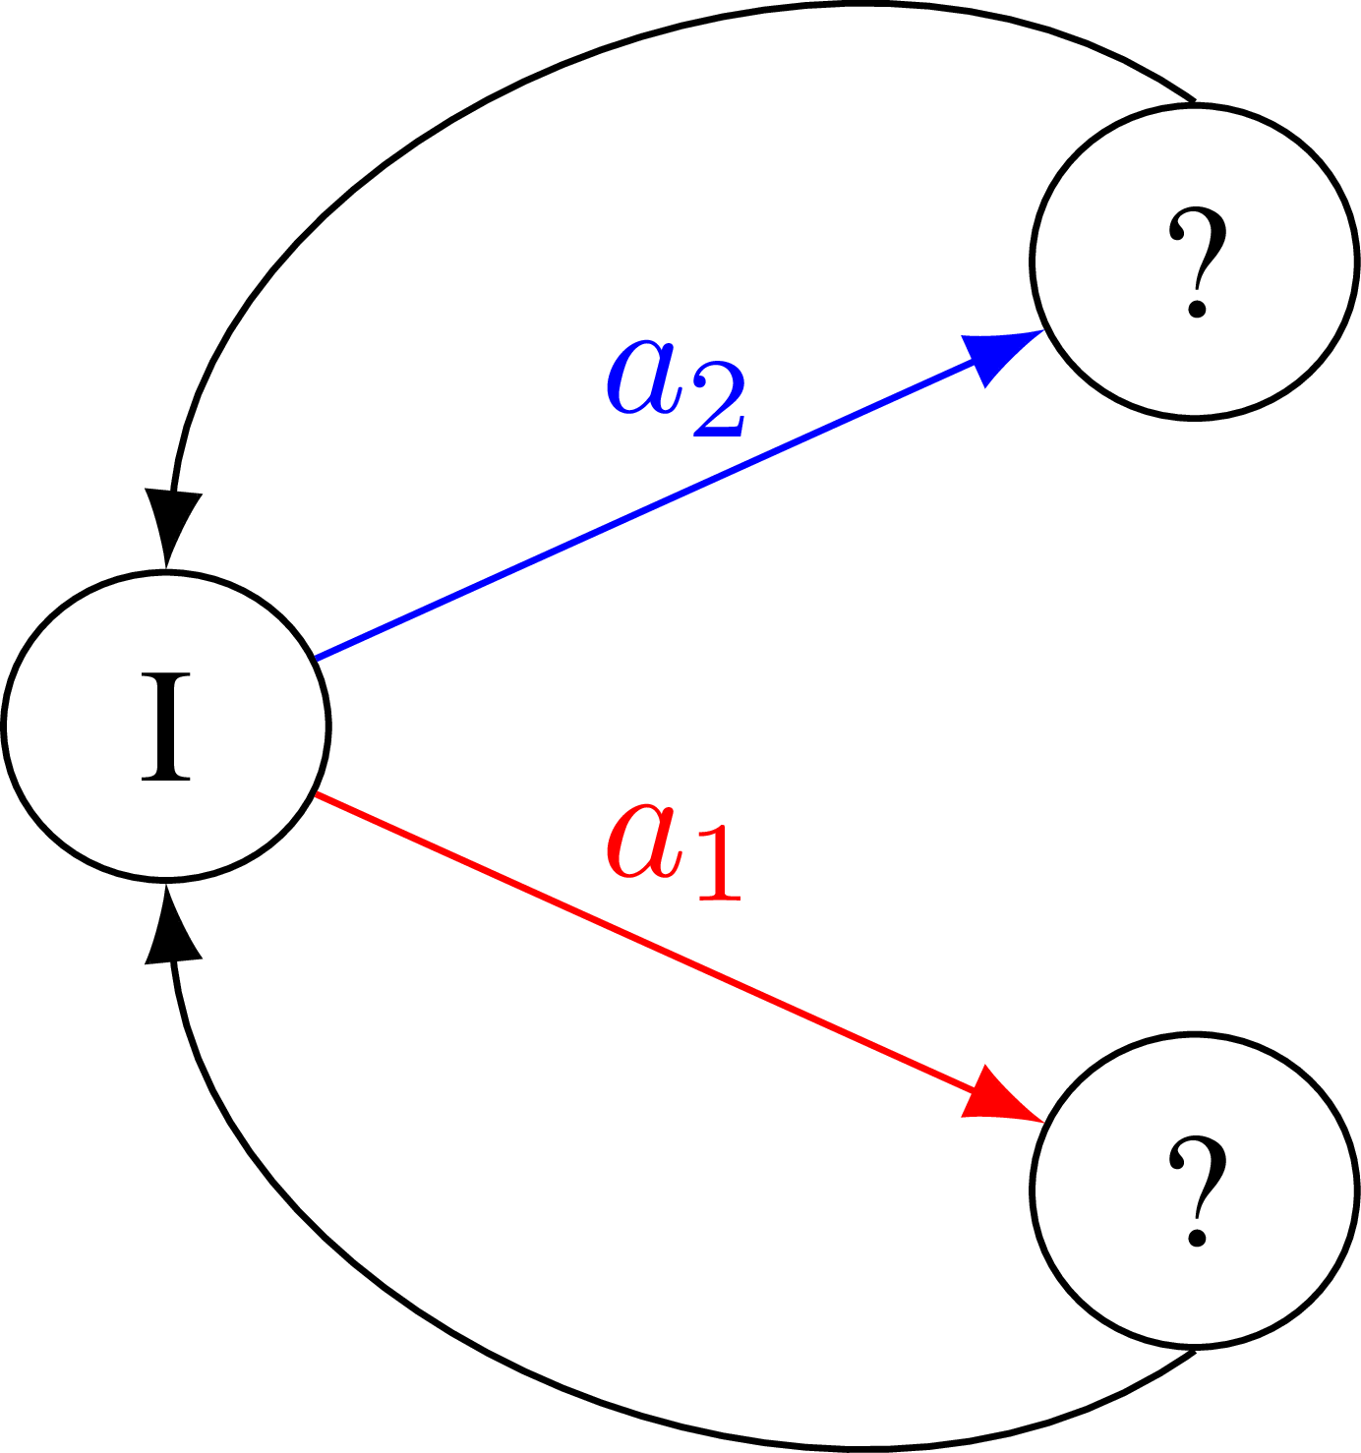
Adversary’s Rectangularity
SA-rectangularity:
S-rectangularity:

Slide 9
S-Rectangularity: An Example
Inventory control:
{$D_{t}:t≥0\}$ i.i.d. is the demand process and $a_{t}$ is the ordered inventory.
It natural to assume that at each time t, the adversary can only change the law of $D_{t}$ dependent on $I_{t}$ but not dependent on the controller's action $a_{t}$.
S-rectangularity.

Slide 10
SA-Rectangularity
Most used setting in the DRRL literature.
Same table for deterministic controller.

Slide 11
S-Rectangularity with Convex Ambiguity Sets
Not the same table for deterministic controller!

Slide 12
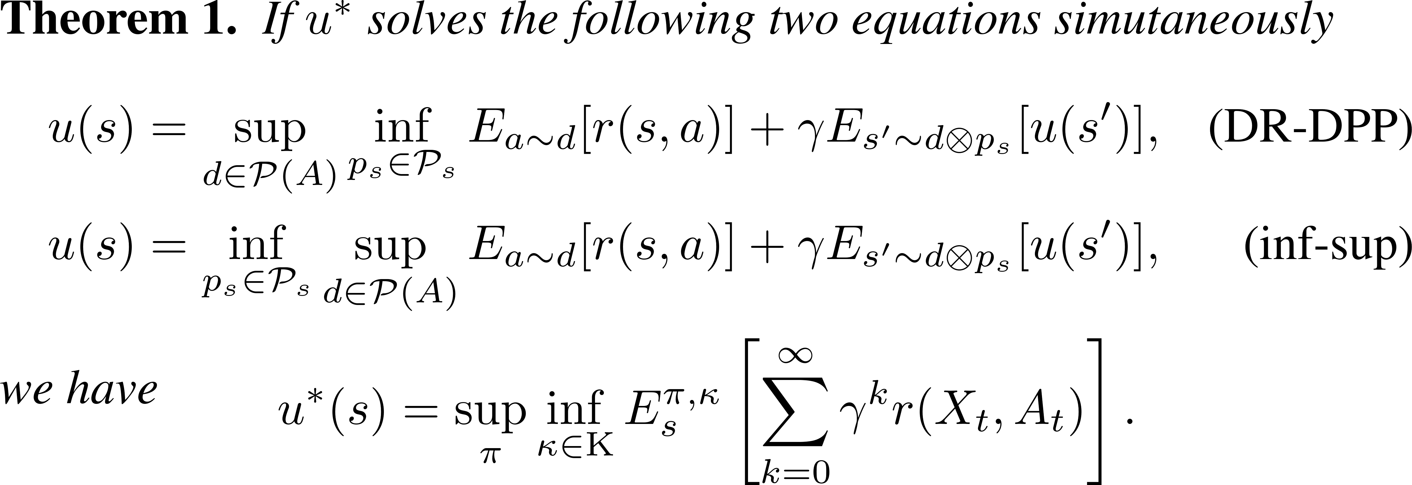
The Master Theorem

Slide 13
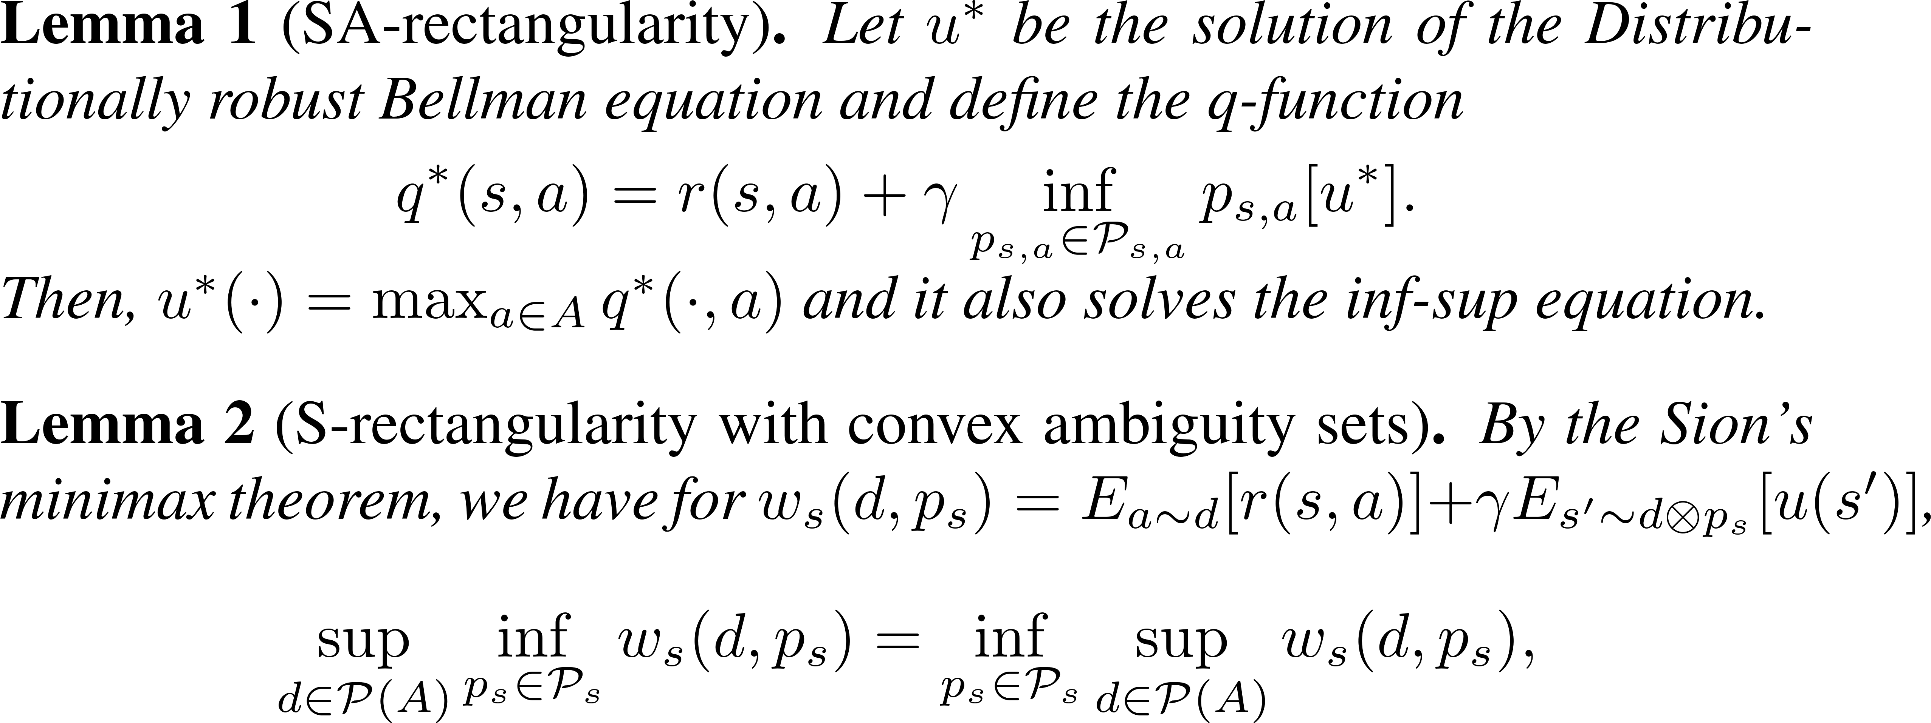
The Master Theorem: Implementation

Slide 14
S-Rectangularity with Non-Convex Ambiguity Sets
In this talk, we show counterexamples.
Not the same table for deterministic controller!

Slide 15
A Counterexample
History-dependent controller Versus Markov Time-Homogeneous Adversary
The solution to the DR-DPP:
History-dependent policy:
At time 0, randomly pick one action at state I.
If state G, choose the same action for the following time steps at state I.
If state B, choose the alternative action for the following time steps at state I.
For any Markov time-homogeneous adversary $κ,$
Bandit learning!

Slide 16
S-Rectangularity with Deterministic Controllers

Slide 17
Main Message
Dynamic programming principle is often applicable in distributionally robust Markov decision processes with various natural / practical constraints.
BUT NOT ALWAYS!

Slide 18
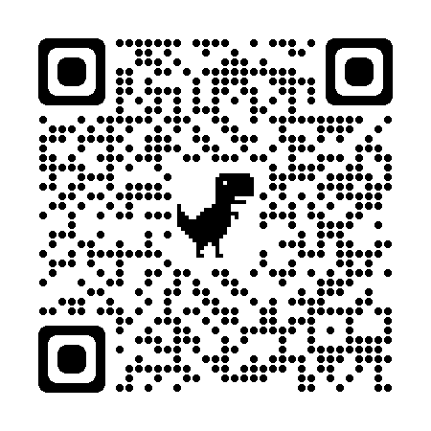
https://arxiv.org/abs/2311.09018
Q&A?

