Slide 1
Statistical Learning of Distributionally Robust Stochastic Control in Continuous State Spaces
Shengbo Wang (Stanford)
Nian Si (Stanford → University of Chicago → HKUST)
Jose Blanchet (Stanford)
Zhengyuan Zhou (NYU)

Slide 2
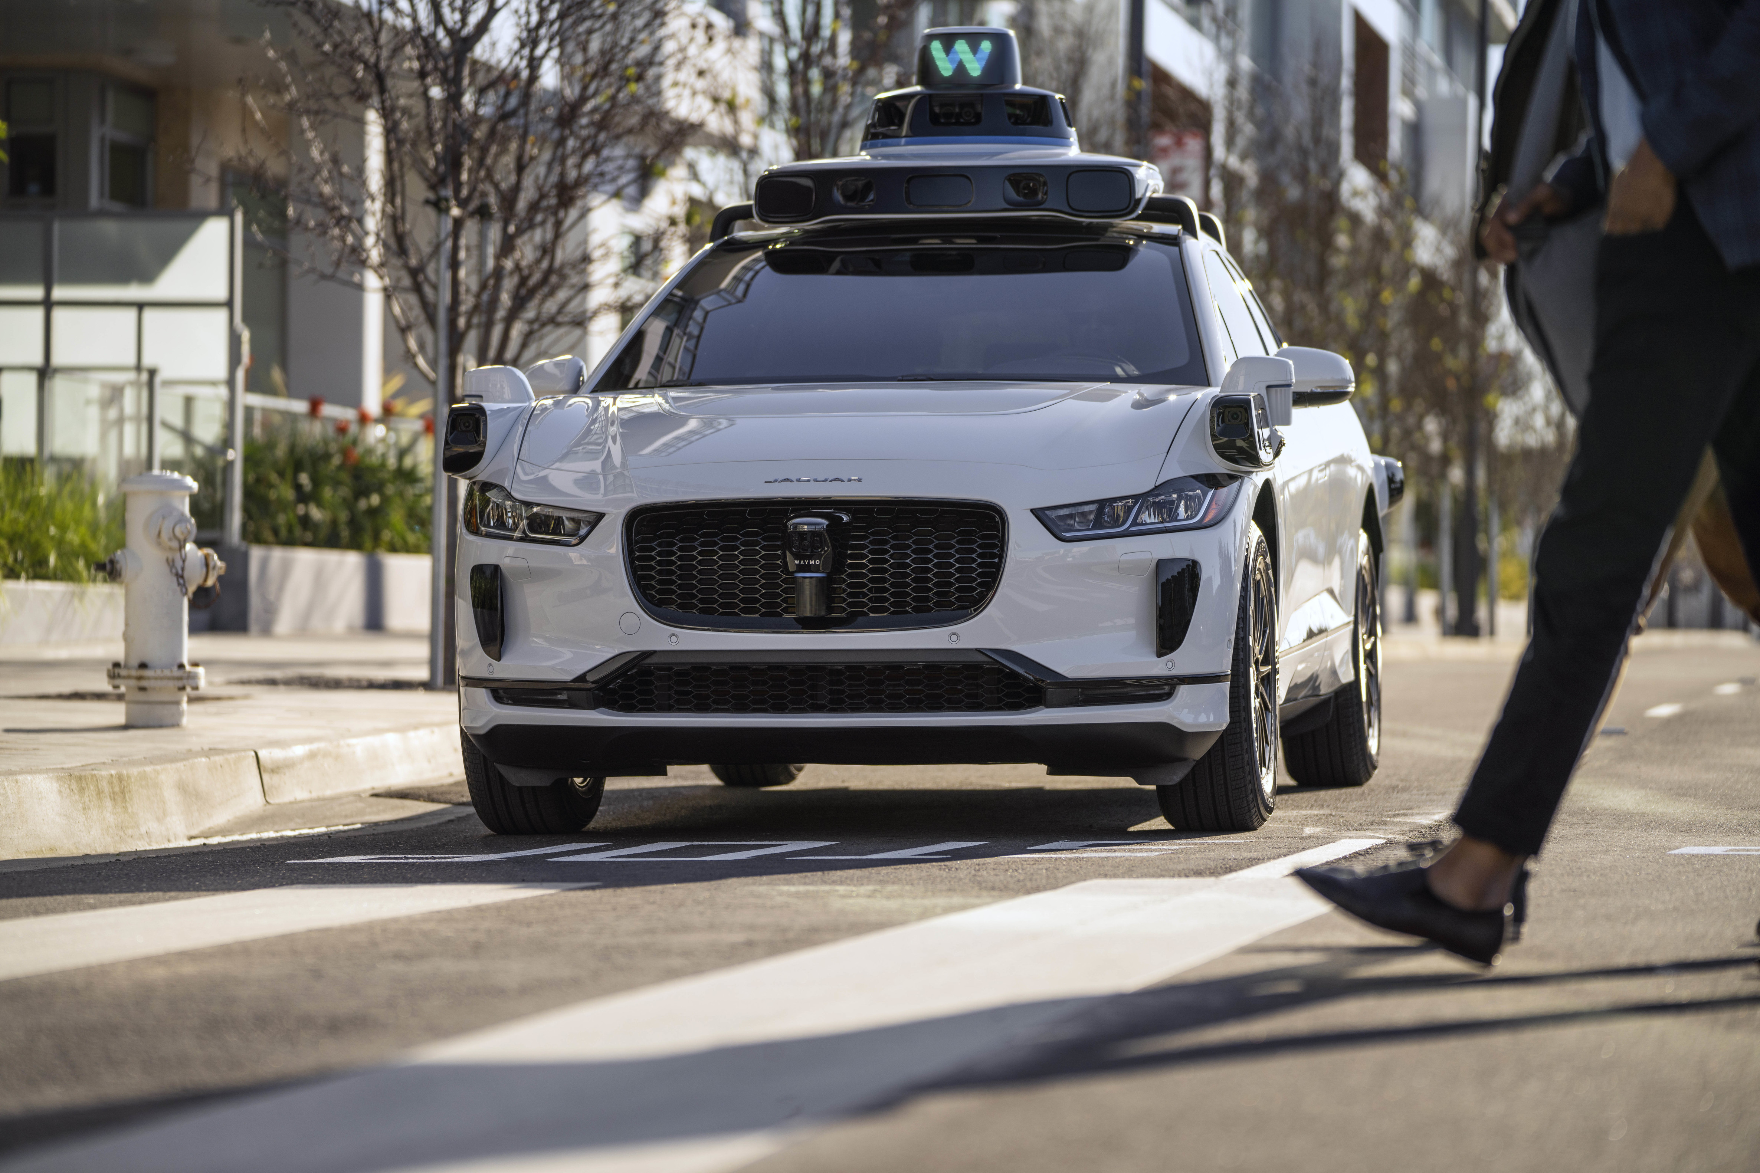
Motivation: Auto-Driving Car Trained from a Simulator
Real environment
Simulator

Slide 3
Distributionally Robust MDP

Slide 4
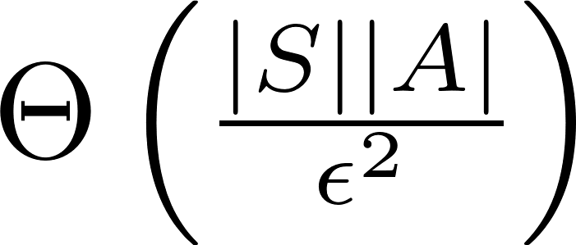
Distributionally Robust MDP
Continuous state and actions?
Too conservative…
We may know some information about the dynamics.
4

Slide 5
Example: Inventory Control
Inventory control:
{$D_{t}:t≥0\}$ is the demand process and $A_{t}$ is the ordered inventory.
${\{D}_{t}\}$ unknown, but the following functional form is known.
Only need to robustify the uncertainty around ${\{D}_{t}\}.$

Slide 6
Research Questions
What are formulations of distributional robust stochastic control problems?
What are statistical learning complexities?

Slide 7
Content
Formulation
Current-Action-Aware Adversary
Current-Action-Unaware Adversary
Bellman equations
Statistical complexities

Slide 8
Formulation
State: X; action: A, randomness: W.
A known state dynamic function:
A known reward function:

Slide 9
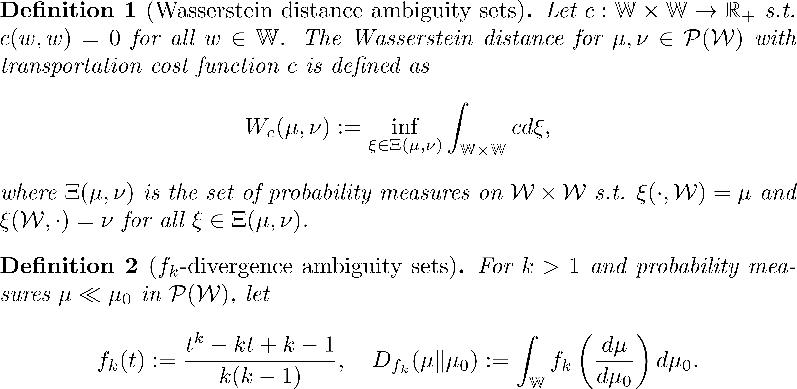
Uncertainty Set

Slide 10
Statistical Learning Problem
How many i.i.d. samples from $μ_{0}$ is sufficient to learn $v^{∗}$ with $ε$ error?

Slide 11
Adversaries
Current-action-aware (CAA) adversary:
Define the filtration
The adversarial choice:
SA-rectangularity.
Current-action-unaware (CAU) adversary:
Define the filtration
The adversarial choice:
S-rectangularity.

Slide 12
Bellman Equations
Current-action-aware case:
Current-action-unaware case:

Slide 13
Dynamic Programming Principle
Remark: this proposition is not trivial. In fact, if the controller and the adversary are not “symmetric”, Proposition 1 may not be true.
Wang, Shengbo, Nian Si, Jose Blanchet, and Zhengyuan Zhou. "On the foundation of distributionally robust reinforcement learning." arXiv preprint arXiv:2311.09018 (2023).

Slide 14
Statistical Learning Algorithm
Let $\hat{u}$ be the solution of the empirical Bellman equation.
Lipschitz assumption:
We will upper bound ${\left||\hat{u}−u^{∗}|\right|}_{∞}.$

Slide 15
Results

Slide 16
Application: Portfolio Optimization
Suppose that there are m assets:
$−1^{T}A_{t}≥0$ is the consumption at time t.
Reward function:
Samples from $R_{t}.$
Build uncertainty sets around the empirical measure.

Slide 17
Conclusion
Distributional robust stochastic control with a known state recursion is a more natural formulation in many contexts.
The sample complexities could be derived even for continuous state-action spaces.
Potentially less conservative and easy to learn.
Takeaway: A well-crafted formulation that uses available information effectively is crucial for the DRO problem to ensure tractability, learnability, and reduced conservativeness.

Slide 18
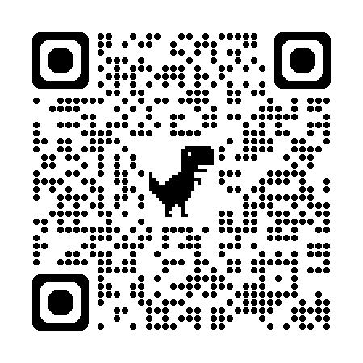
Q & A
Arxiv: 2406.11281

